Slide 1
Distributed Shared Memory
分布式共享内存

Slide 2
Distributed Shared Memory
使计算机集群的主存储器看起来就像一个具有单一地址空间的单一存储器。
Then can use shared memory programming techniques.
然后可以使用共享内存编程技术。

Slide 3
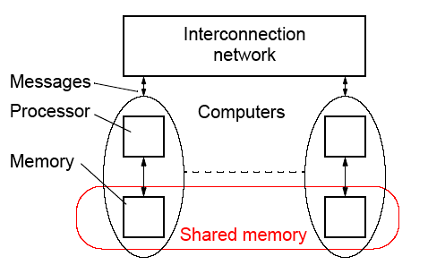
DSM System
Still need messages or mechanisms to get data to processor, but
these are hidden from the programmer:
DSM系统仍然需要消息或机制获得数据到处理器，但这些对程序员隐藏

Slide 4
Advantages of DSM
优点
• System scalable系统可扩展性
• Hides the message passing - do not explicitly specific sending
messages between processes
隐藏消息传递——不要显式地指定在进程之间发送消息
• Can use simple extensions to sequential programming
可以使用顺序编程的简单扩展
• Can handle complex and large data bases without replication
or sending the data to processes
可以处理复杂和大型的数据库，而不需要复制或发送数据到进程

Slide 5
Disadvantages of DSM
缺点
• May incur a performance penalty
可能导致性能损失
必须提供保护，防止同时访问“共享数据(锁等)”
对实际生成的消息几乎没有程序员控制
特别是不规则问题的处理可能比较困难
• Must provide for protection against simultaneous access to
shared data (locks, etc.)
• Little programmer control over actual messages being generated
• Performance of irregular problems in particular may be difficult

Slide 6
Methods of Achieving DSM
• Hardware
Special network interfaces and cache coherence circuits
特殊的网络接口和高速缓存一致性电路。
• Software
Modifying the OS kernel
Adding a software layer between the operating system and the application - most convenient way for teaching
purposes
修改操作系统内核。
在操作系统和应用程序之间添加一个软件层——这是最方便的教学方式

Slide 7
Software DSM Implementation
• Page based - Using the system’s virtual memory
基于页面——使用系统的虚拟内存
• Shared variable approach- Using routines to access
shared variables
共享变量方法——使用例程访问共享变量
• Object based- Shared data within collection of objects.
Access to shared data through object oriented discipline
(ideally)
基于对象——对象集合中的共享数据。
通过面向对象原则访问共享数据

Slide 8
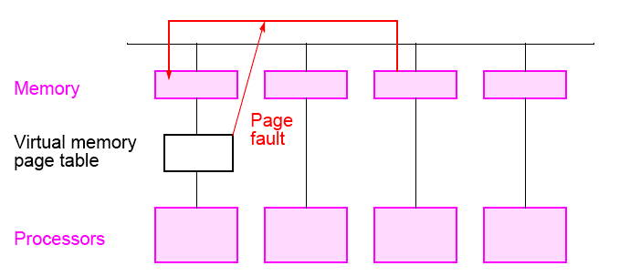
Software Page Based DSM Implementation
基于软件页面的DSM实现
虚拟内存页表
处理器

Slide 9
Some Software DSM Systems
• Treadmarks
Page based DSM system基于页面的DSM系统
Apparently not available now
• JIAJIA
C based
Obtained at UNC-Charlotte but required significant
modifications for our system (in message-passing calls)在UNC-Charlotte获得，但需要对我们的系统进行重大修改(在消息传递中是这样的)
• Adsmith object based
C++ library routines
be installed for teaching

Slide 10
JIAJIA
http://www-users.cs.umn.edu/~tianhe/paper/dist.htm
Characteristics:
  多个工作站的物理内存被组合在一起，形成一个更大的共享空间。
  在其他最近的DSM系统中，such as Quarks, TreadMarks, and CVM。
  共享地址空间受到本地主存大小的限制。在JIAJIA中,共享空间的大小可以是每只机器的本地内存的总和。
  提出了一种适用于范围一致性的基于锁的缓存一致性协议。我们的协议是基于锁的，因为它完全消除了目录，并通过访问锁上的写通知来执行所有与一致性相关的操作。与基于目录的协议相比，基于锁的协议更简单，因而也更高效、可伸缩。.
  提出了一种新的类似于NUMA的内存组织方案，以简化对内存的管理。
  简单的共享内存组织方案和范围一致性语义。JIAJIA完全消除了差分保存、垃圾收集、本地地址到全局地址转换和矢量时间戳维护的复杂性。
  A flexible shared memory allocation call is provided to allow the programmer to control the distribution of shared locations.
  提供了一个灵活的共享内存分配调用，允许程序员控制共享位置的分配。

Slide 11
Platforms
    Currently, JIAJIA runs on SUN SPARCstations running SUNOS4.1.3, Solaris 2.4 or above, IBM SP2 with AIX4.1, Dawning 1000A with AIX 4.1, Dawning 2000I with AIX 4.2, X86-based Linux 2.0 and Windows NT.
People Involved with JIAJIA
    JIAJIA was primarily developed by Prof. Weiwu Hu and Weisong Shi, under the direction of Prof. Zhimin Tang at the Center of High Performance Computing, Institute of Computing Technology, Chinese Academy of Sciences. Zhiyu Zhou ported some applications to JIAJIA. Tian He ported JIAJIA to Windows NT.

Slide 12
Consistency Models
•严格的一致性-
处理器看到最近的更新，也就是说，read返回最近写入的位置。
• 顺序一致性 –
与单个程序交叉执行相同的任何执行的结果。
• 放松一致性-
Delay making write visible to reduce messages.
延迟使写可见以减少消息
• 弱一致性-
程序员必要时使用同步操作来强制顺序一致性。
• 释放一致性 –
程序员必须使用特定的同步操作符，获取和释放。
•延迟发布一致性
——只在获取时进行更新。

Slide 13
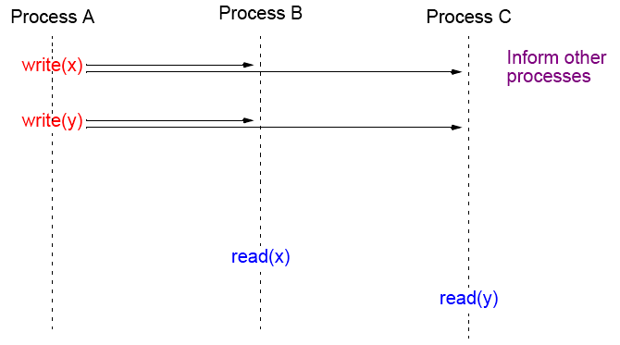
Strict Consistency
Every write immediately visible 每一笔即时可见
通知其他的进程
Disadvantages: number of messages, latency, maybe unnecessary.
缺点:消息数量、延迟，可能不必要。

Slide 14
适用于分布式系统的一致性模型
Release Consistency
释放一致性
弱一致性的扩展，其中同步操作已被指定:
•获取操作——在读取一个或多个共享变量之前使用。
•发布操作——在共享变量被修改(写入)并允许其他进程访问变量之后使用
通常，获取是通过锁操作完成的，然后通过解锁操作释放(尽管不一定)。

Slide 15
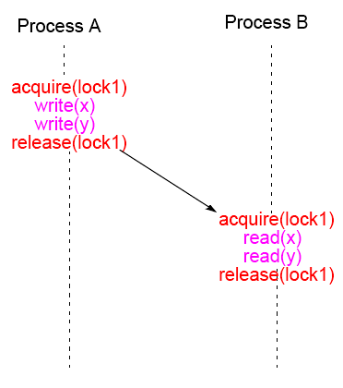
Release Consistency

Slide 16
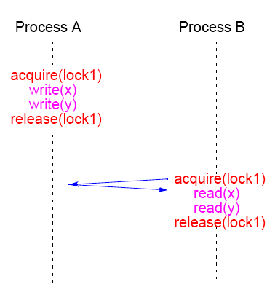
Lazy Release Consistency
Advantages: Fewer messages

Slide 17
Adsmith

Slide 18
Adsmith
• User-level libraries that create distributed shared memory system
on a cluster.
• Object based DSM - memory seen as a collection of objects that
can be shared among processes on different processors.
• Written in C++
• Built on top of pvm
• Freely available
User writes application programs in C or C++ and calls Adsmith
routines for creation of shared data and control of its access.

Slide 19
Adsmith Routines
These notes are based upon material in Adsmith User Interface document.

Slide 20
Initialization/Termination
Explicit initialization/termination of Adsmith not necessary.

Slide 21
Process
To start a new process or processes:
adsm_spawn(filename, count)
Example
adsm_spawn(“prog1”,10);
starts 10 copies of prog1 (10 processes). Must use Adsmith routine to start a new process. Also version of adsm_spawn() with similar parameters to pvm_spawn().

Slide 22
Process “join”
adsmith_wait();
will cause the process to wait for all its child processes (processes it created) to terminate.
Versions available to wait for specific processes to terminate, using pvm tid to identify processes. Then would need to use the pvm form of adsmith() that returns the tids of child processes.

Slide 23
Access to shared data (objects)
Adsmith uses “release consistency.” Programmer explicitly needs to control competing read/write access from different processes.
Three types of access in Adsmith, differentiated by the use of the
shared data:
• Ordinary Accesses - For regular assignment statements
accessing shared variables.
• Synchronization Accesses - Competing accesses used for
synchronization purposes.
• Non-Synchronization Accesses - Competing accesses, not
used for synchronization.

Slide 24
Ordinary Accesses - Basic read/write actions
Before read, do:
adsm_refresh()
to get most recent value - an “acquire/load.” After write, do:
adsm_flush()
to store result - “store”
Example
int *x; //shared variable
.
.
adsm_refresh(x);
a = *x + b;

Slide 25
Synchronization accesses
To control competing accesses:
• Semaphores
• Mutex’s (Mutual exclusion variables)
• Barriers.
available. All require an identifier to be specified as all three class instances are shared between processes.

Slide 26
Semaphore routines
Four routines:
wait()
signal()
set()
get().
class AdsmSemaphore {
public:
AdsmSemaphore( char *identifier, int init = 1 );
void wait();
void signal();
void set( int value);
void get();
};

Slide 27
Mutual exclusion variables – Mutex
Two routines
lock
unlock()
class AdsmMutex {
public:
AdsmMutex( char *identifier );
void lock();
void unlock();
};

Slide 28
Example
int *sum;
AdsmMutex x(“mutex”);
x.lock();
adsm_refresh(sum);
*sum += partial_sum;
adsm_flush(sum);
x.unlock();

Slide 29
Barrier Routines
One barrier routine
barrier()
class AdsmBarrier {
public:
AdsmBarrier( char *identifier );
void barrier( int count);
};

Slide 30
Example
AdsmBarrier barrier1(“sample”);
.
.
barrier1.barrier(procno);

Slide 31
Non-synchronization Accesses
For competing accesses that are not for synchronization:
adsm_refresh_now( void *ptr );
And
adsm_flush_now( void *ptr );
refresh and flush take place on home location (rather than locally) and immediately.

Slide 32
Features to Improve Performance
Routines that can be used to overlap messages or reduce number of messages:
• Prefetch
• Bulk Transfer
• Combined routines for critical sections

Slide 33
Prefetch
adsm_prefetch( void *ptr )
used before adsm_refresh() to get data as early as possible.
Non-blocking so that can continue with other work prior to issuing refresh.

Slide 34
Bulk Transfer
Combines consecutive messages to reduce number. Can apply
only to “aggregating”:
adsm_malloc( AdsmBulkType *type );
adsm_prefetch( AdsmBulkType *type )
adsm_refresh( AdsmBulkType *type )
adsm_flush( AdsmBulkType *type )
where AdsmBulkType is defined as:
enum AdsmBulkType {
adsmBulkBegin,
AdsmBulkEnd
}
Use parameters AdsmBulkBegin and AdsmBulkEnd in pairs to
“aggregate” actions.
Easy to add afterwards to improve performance.

Slide 35
Example
adsm_refresh(AdsmBulkBegin);
adsm_refresh(x);
adsm_refresh(y);
adsm_refresh(z);
adsm_refresh(AdsmBulkEnd);

Slide 36
Routines to improve performance of critical sections
仲裁和共享对象不在一个服务器，会出现每次操作都是两条消息

Slide 37
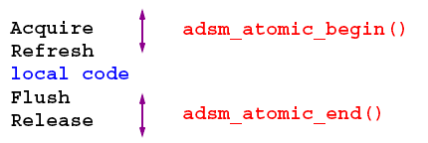
Routines to improve performance of critical sections
Called “Atomic Accesses” in Adsmith.
adsm_atomic_begin()
adsm_atomic_end()
Replaces two routines and reduces number of messages.

Slide 38
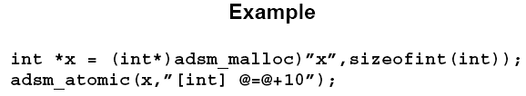
Sending an expression to be executed on home process
Can reduce number of messages. Called “Active Access” in
Adsmith. Achieved with:
adsm_atomic(void *ptr, char *expression);
where the expression is written as [type] expression.
Object pointed by ptr is the only variable allowed in the expression
(and indicated in this expression with the symbol @).

Slide 39
Collect Access
Efficient routines for shared objects used as an accumulator:
void adsm_collect_begin(void *ptr, int num);
void adsm_collect_end(void *ptr);
where num is the number of processes involved in the access, and *ptr points to the shared accumulator
Example
(from page 10 of Adsmith User Interface document):
int partial_sum = ... ; // calculate the partial sum
adsm_collect_begin(sum,nproc);
sum+=partial_sum; //add partial sum
adsm_collect_end(sum); //total; sum is returned

Slide 40
Other Features
Pointers
Can be shared but need to use adsmith address translation routines to convert local address to a globally recognizable address and back to an local address:
To translates local address to global address (an int)
int adsm_gid(void *ptr);
To translates global address back to local address for use by
requesting process
void *adsm_attach(int gid);

Slide 41
Message passing
Can use PVM routines in same program but must use
adsm_spawn() to create processes (not pvm_spawn(). Message tags MAXINT-6 to MAXINT used by Adsmith.

Slide 42
Information Retrieval Routines
For getting host ids (zero to number of hosts -1) or process id (zero to number of processes -1):
int adsm_hostno(int procno = -1);
- Returns host id where process specified by process number
procno resides. (If procno not specified, returns host id of calling
process).
int adsm_procno();
-Returns process id of calling process.
int adsm_procno2tid(int procno);
Translates process id to corresponding PVM task id.
int adsm_tid2procno(int tid)
translates PVM task id to corresponding process id.

Slide 43
DSM Implementation Projects
Using underlying message-passing software
• Easy to do
• Can sit on top of message-passing software such as MPI.

Slide 44
Issues in Implementing a DSM System
• Managing shared data - reader/writer policies
• Timing issues - relaxing read/write orders

Slide 45
Reader/Writer Policies
• Single reader/single writer policy - simple to do with
centralized servers
• Multiple reader/single writer policy - again quite simple
to do
• Multiple reader/multiple writer policy - tricky

Slide 46
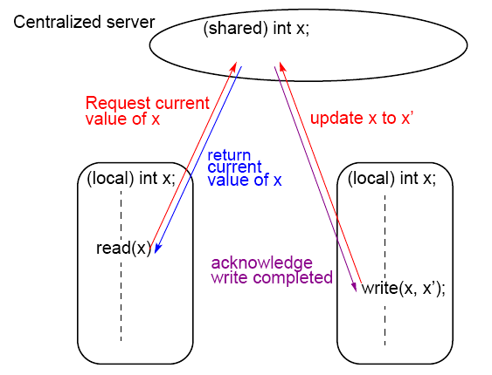
Simple DSM system using a centralized server

Slide 47
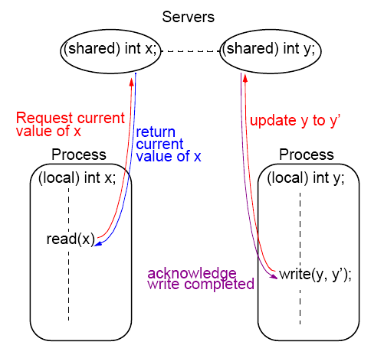
Simple DSM system using multiple servers

Slide 48
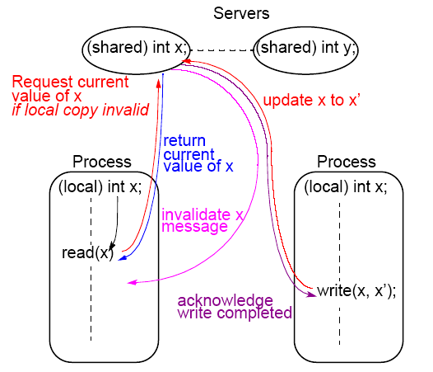
Simple DSM system using multiple servers and multiple reader policy

Slide 49
Shared Data with Overlapping Regions A New Concept Developed at UNC-Charlotte
Based upon earlier work on so-called over-lapping connectivity interconnection networks
A large family of scalable interconnection networks devised – all have characteristic of overlapping domains that nodes can
Interconnect
Many applications require communication to logically nearby
processors

Slide 50
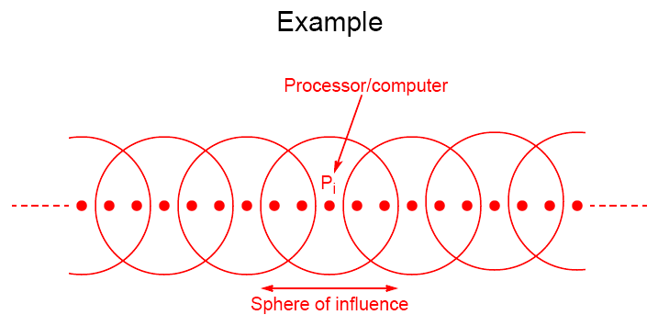
Overlapping Regions

Slide 51
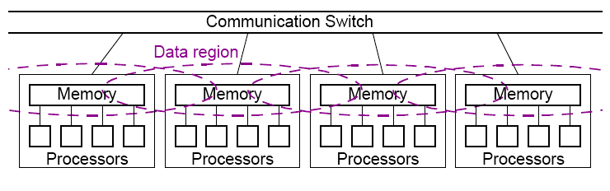
Symmetrical Multiprocessor System with
Overlapping Data Regions

Slide 52
Static and Dynamic Overlapping Groups
• Static - defined prior to program execution – add
routines for declaring and specifying these groups
• Dynamic - shared variable migration during program
execution

Slide 53
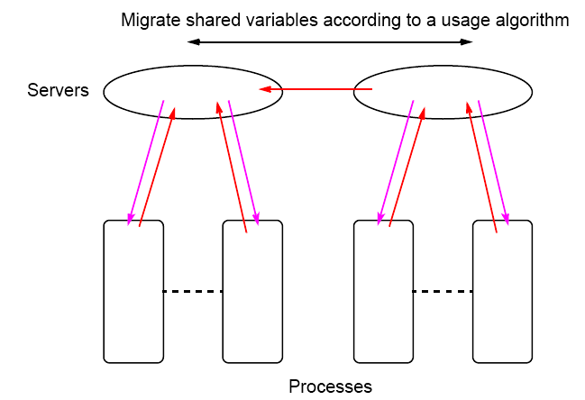
Shared Variable Migration between Data Regions

Slide 54
DSM Projects
• Write a DSM system in C++ using MPI for the underlying
message-passing and process communication.
• Write a DSM system in Java using MPI for the underlying
message-passing and process communication.
• (More advanced) One of the fundamental disadvantages of
software DSM system is the lack of control over the
underlying message passing. Provide parameters in a DSM
routine to be able to control the message-passing. Write
routines that allow communication and computation to be
overlapped.

Slide 55
Assignment in class
1. 请用公式推导Amdahl定律？并用实例解释Amdahl定律。
2. 请用实例解释伯恩斯坦条件。
假设系统某个部分的初始时间与 T1 的比值为 a ，则这部分的初始时间为 a*T1，然后我们给这部分优化，优化的比例因子为k，则优化后这部分所需时间为a * T1 / k。
我们先把 T1 拆开：T1 = a * T1 + (1 - a) * T1
将优化后的时间a * T1 / k代入得到 T2
T2 = a * T1 + (1 - a) * T1 / k1所以S = (T1 / T2) = 1 / (1 - a + a / k)
阿姆达尔这个模型 定义了固定负载下，某个算法的并行实现相对串行实现的加速比。例如，某个算法有12%的操作是可以并行执行的，而剩下的88%的操作不能并行，那么阿姆达尔定律声明，最大加速比是1/（1-0.12）=1.136。如上公式n趋向于无穷大，那么加速比S=1/B=1/（1-0.12）。

